Slide 1

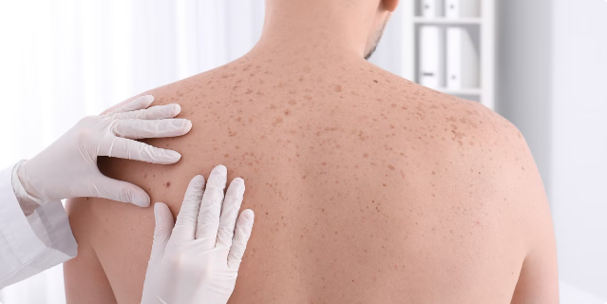
Skin Cancer Classification Test
This project aims to develop a robust machine learning model for classifying skin cancer using dermatoscopic images. The goal is to assist dermatologists in making quicker and more accurate diagnoses, ultimately leading to improved early detection and treatment of skin cancer.
Presented By:
M Hanumantharao 21BIT0487
Navaneeth S 21BIT0464
Under Guidance:
Prof. Vanmathi C

Slide 2

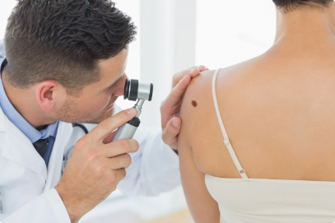
Introduction
1
Model Development
2
Dataset Utilization
The primary objective is to create a robust machine learning model capable of accurately classifying skin cancer based on dermatoscopic images.
The HAM10000 dataset, containing a diverse collection of dermatoscopic images, will be used to train and test the model.
3
Skin Lesion Types
4
Clinical Assistance
The model will be trained to identify and classify various types of skin lesions, including melanoma, basal cell carcinoma, and others.
The aim is to provide dermatologists with a valuable tool that can assist in making faster and more accurate diagnoses, ultimately improving patient care.

Slide 3


Motivation
Prevalence and Rise
Skin cancer is a significant public health concern, with its prevalence steadily increasing worldwide.
Early Detection Importance
Early detection of skin cancer is crucial for successful treatment and improved survival rates.
Diagnostic Challenges
Diagnosing skin cancer can be challenging due to the subtle differences between various types of lesions.
Machine Learning Enhancement
Machine learning offers a promising approach to enhance diagnostic accuracy and provide valuable support to dermatologists.

Slide 4
Background
1
Skin Cancer Types
A comprehensive understanding of different skin cancer types, including melanoma, basal cell carcinoma, squamous cell carcinoma, and others, is essential.
2
Characteristics and Prevalence
The project will delve into the characteristics, prevalence, and diagnostic challenges associated with each type of skin cancer.
3
Machine Learning in Medical Imaging
The evolution of machine learning in medical image analysis will be explored, highlighting its potential to revolutionize diagnosis and treatment.
4
Deep Learning Promise
The project will leverage the power of deep learning models, specifically convolutional neural networks (CNNs), to achieve consistent and accurate diagnoses.
5
HAM10000 Dataset
The HAM10000 dataset, a valuable resource containing high-quality dermatoscopic images, will be used for model training and evaluation.

Slide 5
Project Description and Goals
CNN-Based System
Dataset Preparation
Model Development
The project will develop a convolutional neural network (CNN)-based system to automate the classification of skin lesions, enhancing diagnosis speed and accuracy.
The HAM10000 dataset will be meticulously prepared, involving tasks such as image resizing, augmentation, and normalization to ensure optimal model training.
A CNN model will be designed and trained using TensorFlow, optimized for high accuracy in classifying skin lesions. UI is developed using python framework.

Slide 6

Technical Specification
Platform
TensorFlow
Hardware Requirements
GPU, CPU
Dataset
HAM10000
Software Requirements
Python, TensorFlow

Slide 7






Design Approach and Details
Model Training Phase
The dataset will be prepared using data augmentation techniques such as resizing, normalization, rotation, and flipping to improve model generalization.
CNN Architecture
A CNN architecture will be designed, incorporating convolutional, pooling, and fully connected layers, with hyperparameters tuned for optimal performance.
Training Methodology
The model will be trained on a portion of the dataset, employing cross-validation to optimize hyperparameters and minimize loss.
Model Inference Phase
The trained model will be integrated into a backend server for deployment, capable of processing user-uploaded images.
Deployment Architecture
The deployment architecture will include a user interface for image uploads, backend services for model inference, and data storage for managing inputs, logs, and outputs.
System Efficiency
The deployed system will be designed to ensure scalability and real-time responsiveness, providing accurate and timely skin lesion classifications.

Slide 8

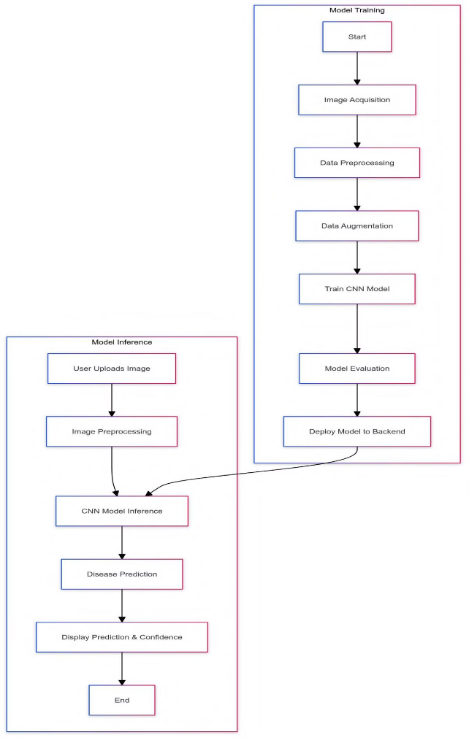



Architecture Approach
User Interface
Clinicians can upload dermatoscopic images for analysis.
Machine Learning Model
The trained CNN model analyzes uploaded images and generates predictions.
Results Visualization
The model's predictions are presented to the user in a clear and concise format, supporting informed decision-making.

Slide 9
Scope
1
Dataset Utilization
2
CNN Development
3
Data Augmentation
The HAM10000 dataset will be used for training and testing the skin cancer classification model.
A convolutional neural network (CNN) will be developed using TensorFlow for accurate skin lesion classification.
Data augmentation techniques will be applied to improve model generalization and performance.
4
User Interface
5
Validation and Deployment
A user-friendly interface will be created for clinicians to upload images and receive real-time predictions.
The system will be rigorously validated and deployed to ensure accuracy and practical application in clinical settings.

Slide 10

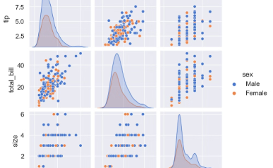

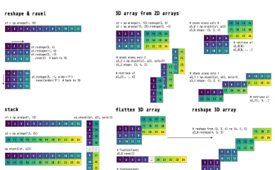
Libraries Used
TensorFlow and Keras
Seaborn and Matplotlib
Imbalanced-learn (imblearn)
NumPy
NumPy will be used for numerical operations and array manipulations that are essential for data processing.
TensorFlow will be used for building and training the CNN model, while Keras will provide a high-level API for constructing and compiling the model.
These libraries will be used to create visualizations and plots for analyzing and presenting data insights.
The RandomOverSampler from imblearn will be used to address class imbalance in the dataset.

Slide 11

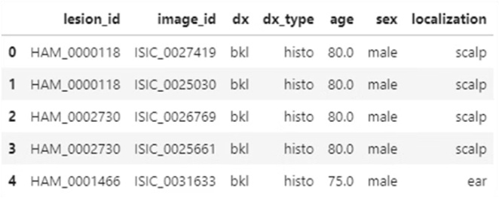
Exploratory Data Analysis
1
Data Collection
The initial stage involved collecting a comprehensive dataset of dermatoscopic images. The HAM10000 dataset, comprising over 10,000 images of various skin lesions, was utilized for this purpose.
2
Data Preprocessing
The collected dataset underwent thorough preprocessing to ensure consistency and enhance model performance. This included resizing images, normalizing pixel values, and handling missing data.
3
Data Augmentation
To improve the model's generalization ability and prevent overfitting, data augmentation techniques were employed. These techniques involved generating synthetic images by applying transformations such as rotation, flipping, and scaling.
4
Feature Extraction
The preprocessed images were then fed into the CNN model for feature extraction. The CNN layers automatically learned discriminative features from the images, capturing patterns and characteristics relevant to skin cancer detection.

Slide 12
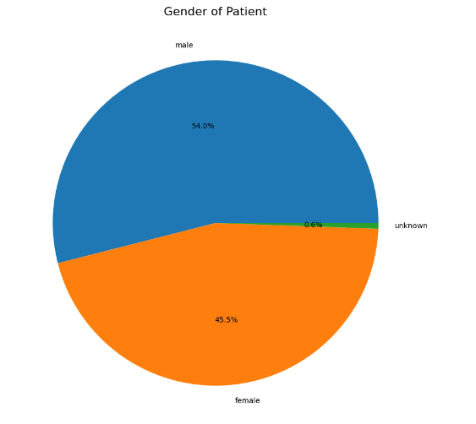
Distribution of Disease over Gender

Slide 13

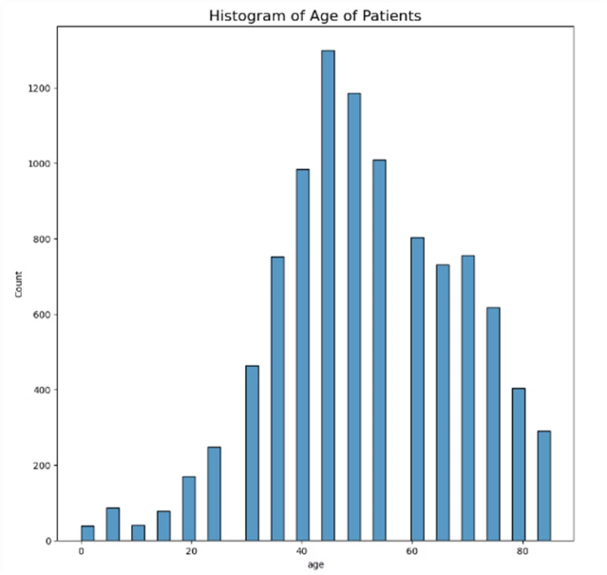
Histogram of Age of Patients

Slide 14

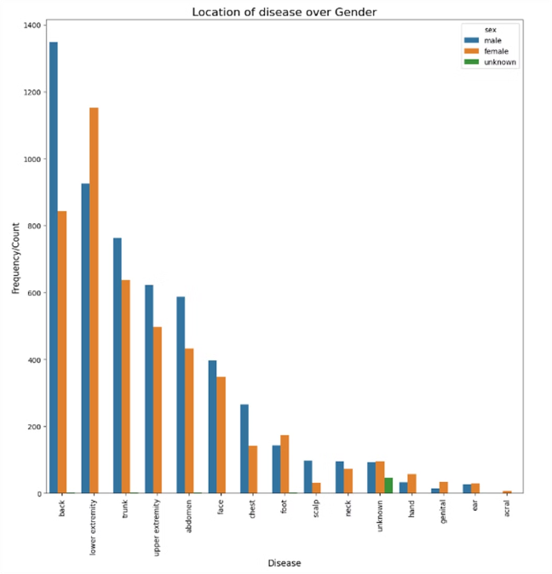
Location of disease over Gender
Head & Neck
Skin cancer on the head and neck is common in both genders, but slightly more prevalent in males.
Trunk
The trunk is another common site for skin cancer, with a similar distribution between genders.
Limbs
Skin cancer on the limbs is more prevalent in females, particularly on the lower limbs.

Slide 15
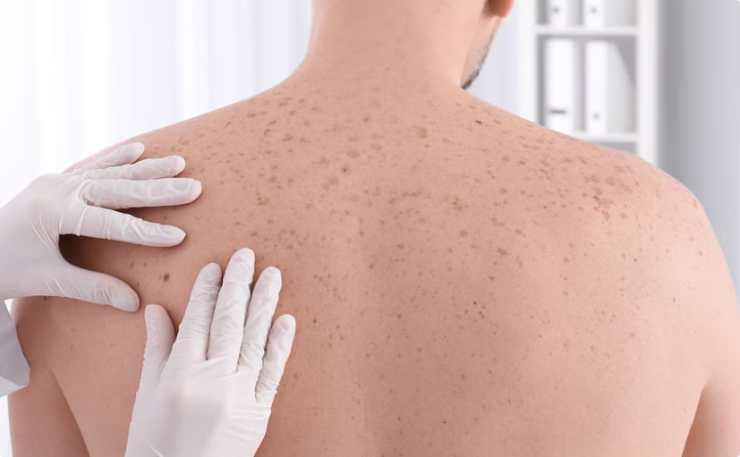
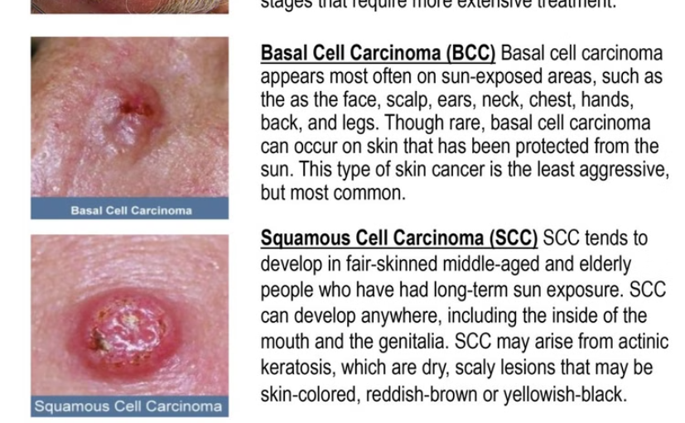
Model Training Output Samples
Model Training results
The Dataset in thoroughly processed using all the sample size of data present in it. Improving the accuracy and authenticity of the results.

Slide 16
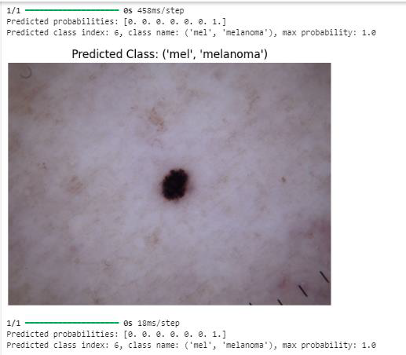
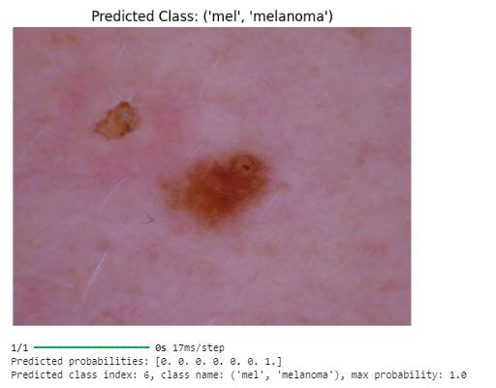

Slide 17
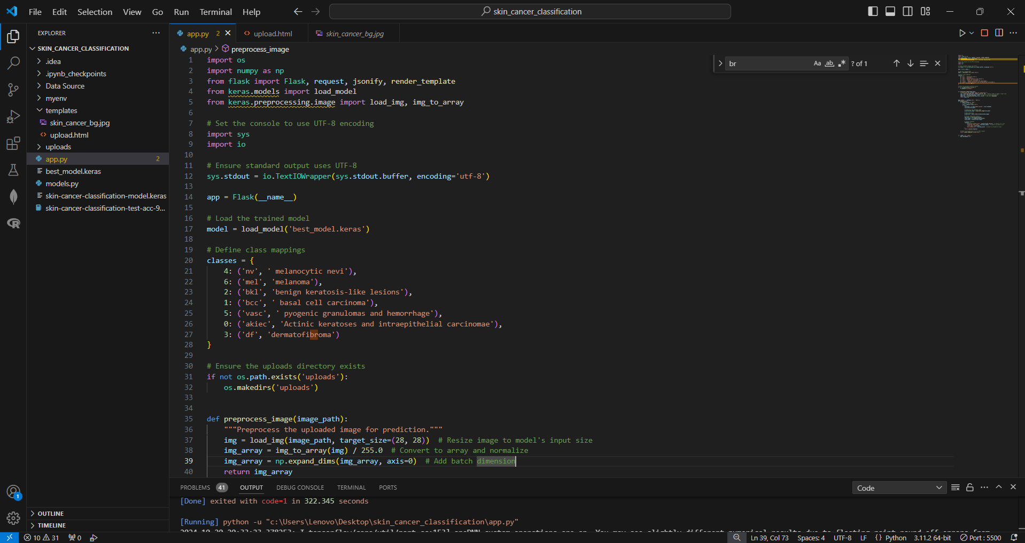
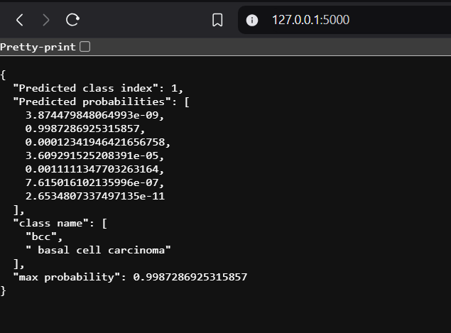
UI Output Samples
App.py – For Image Upload
Diagnostic Feedback
The user interface allows for easy image uploads, enabling real-time analysis.
The system provides clear and concise diagnostic feedback, including the predicted type of skin cancer and its severity.

Slide 18
Project Timeline
Phase 1: Planning and Research
1
Define objectives and finalize the project plan. Milestone: Requirements Document.
2
Phase 2: Dataset Preparation
Collect, preprocess, and augment the dataset. Milestone: Dataset Ready.
Phase 3: Model Development
3
Develop and train the Convolutional Neural Network (CNN) model.
4
Phase 4: UI Integration and Testing
Integrate the user interface (UI) and test system functionality.
Phase 5: Deployment and Evaluation
5
Deploy the system and evaluate its performance.
6
Phase 6: Documentation and Review
Prepare final documentation and conduct project review.

Slide 19


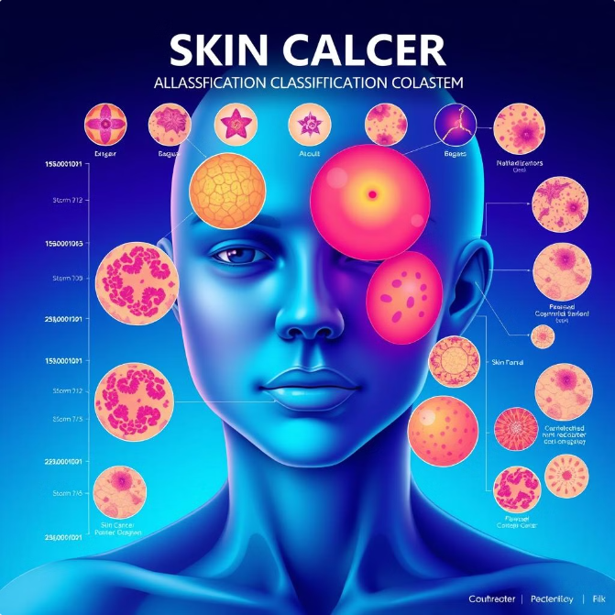



Project Summary
Advanced Skin Cancer Classification
Developed an advanced skin cancer classification system using CNNs and TensorFlow with the HAM10000 dataset of dermatoscopic images.
Model Design and Training
Model design and training included data augmentation and dropout layers to improve generalization and accuracy across various skin lesions.
User Interface Integration
Integrated a user-friendly interface for real-time image uploads and diagnostic feedback, ensuring efficient performance with minimal latency.
System Impact
System supports timely medical intervention, enhancing patient outcomes and reducing healthcare system burdens.

